Slide 1
Customer Delayed Distribution Analysis
From Supply Chain Perspective

Slide 2
Presentation Outline
Problem Statement
Objectives
Affected Customer Pareto Analysis
Historical SKUs Inventory Analysis
Key Takeaways
Q&A

Slide 3
Introduction Section

Slide 4
Problem Statement
As we know, there are several customer complaint about delayed distribution on these country:
Canada
United States
Mexico

Slide 5
Objectives
Determine the most affected customer
Determine the root cause of delayed distribution
Planning further strategy

Slide 6
Analysis Section

Slide 7
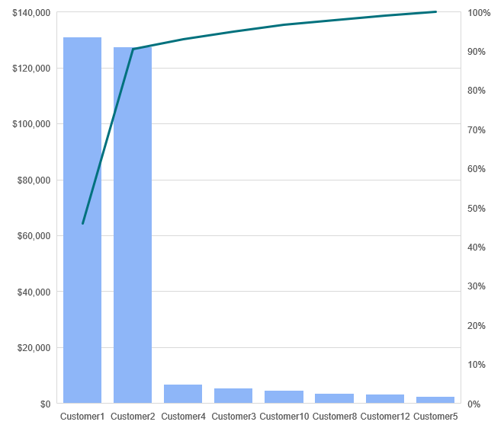
Affected Customer Pareto Analysis
On week 41

Slide 8
Historical SKUs Inventory Analysis
Final inventory on week 41 & 42 are at negative level
At the same week, there are sudden spike of uncovered demand due to increasing demand at week 41 and production pause from week 39 to 41

Slide 9
Closure Section

Slide 10
Key Takeaways
Customer 1 & 2 contribute to 95% sales of delayed distribution
The causing issues are increasing demand at week 41 & production pause on week 39-41
Re-design production planning to tackle delayed production
Integrating production schedule with demand forecasting to enhance production accuracy

Slide 11
Any Question?

